Slide 1


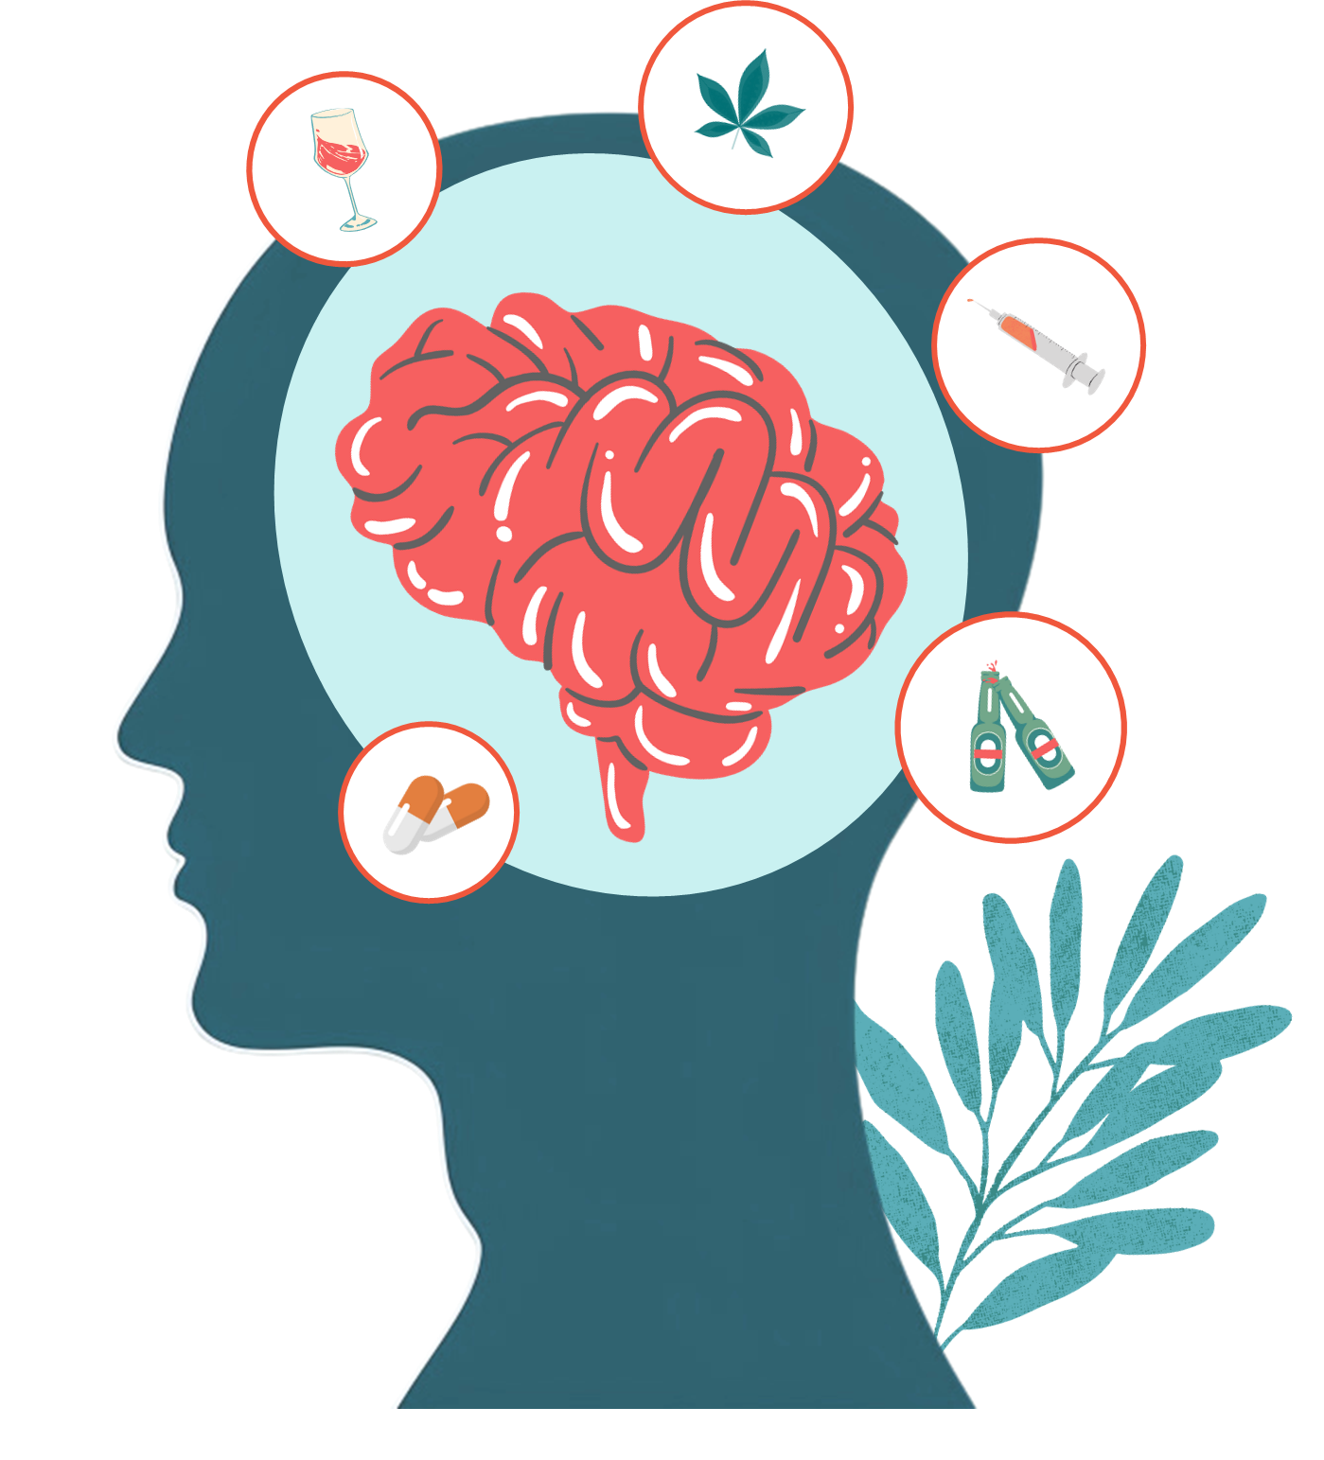


ASSOCIATIONS OF ALCOHOL USE DISORDER WITH SMOKING & DEPRESSION AND CLASSIFYING AUD
Swayam Gupta, Gregory Huynh, Maggie Ma, Lexy Orozco, Rin Self, Aliya Tovar
Notes:
Swayam

Slide 2




Alcohol Use Disorder (AUD)
A medical condition concerning the inability to end or regulate alcohol consumption despite the negative consequences the user faces:
“According to a 2022 national survey, about 1 in 7 men, 1 in 11 women, and 1 in 33 adolescents (aged 12-17) meet the diagnostic criteria for AUD.”
Risks
Symptoms
Alcohol misuse
Past family history or genetics
Consuming alcohol at a young age
Mental health issues
Alcohol overconsumption
Inability to reduce alcohol intake
Continuation of drinking despite consequences
Obsession with alcohol
Notes:
Lexy
Make sure to note that Alcohol use disorder stands for AUD so people can have context :))) - Greg

Slide 3




Depression & Smoking
Studies have found various correlations between AUD, depression, and smoking:
Journal of Affective Disorders Study:
People presenting with depression were less likely to drink and smoke, and vice versa.
Drug and Alcohol Dependence Study:
With the habit of smoking, the chances of developing or having depression increased.
Notes:
Lexy

Slide 4

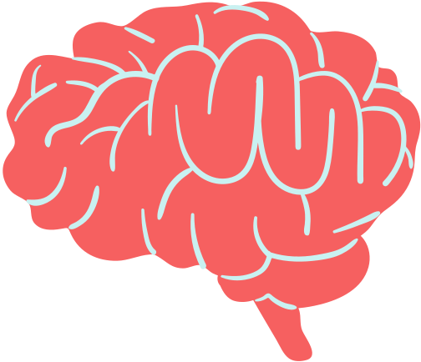
AIMS
1
Comparing DEGs
KNN Classifier
2
Analyze differential expression for smoking status and depression (under control AUD), then determine whether they overlap with the DEGs found for AUD.
Build a K-Nearest Neighbors model for both the prefrontal cortex and the nucleus accumbens regions of the brain in order to assist in the diagnosis of patients with AUD.
Sub-AIM:
Sub-AIM:
Look for potential biological pathways associated with the DEGs we found in both overlapping and non-overlapping genes.
Find the most accurate k number of neighbors to work with.
Notes:
Maggie

Slide 5




Significance of our AIMs
Comparing DEGs
KNN Model
Check whether the AUD DEGs were related to depression or smoking status
Use biological pathways to identify underlying mechanisms of differential expression
Create a model that identifies AUD through biomarkers
Use a more objective way to diagnose AUD rather than a symptoms checklist
Notes:
Maggie

Slide 6
Data wrangling, filter low count genes, normalize, log transform
OUR WORKFLOW
Data Exploration (PCA)
DEG Statistical Testing
KNN Model to diagnose AUD
Filtered for non-AUD samples
Find DEGs for Smoking/Depression
Build KNN model for both brain regions
Compare with AUD DEGs
Find optimal k for best accuracy
Find enriched biological pathways
Notes:
Swayam

Slide 7
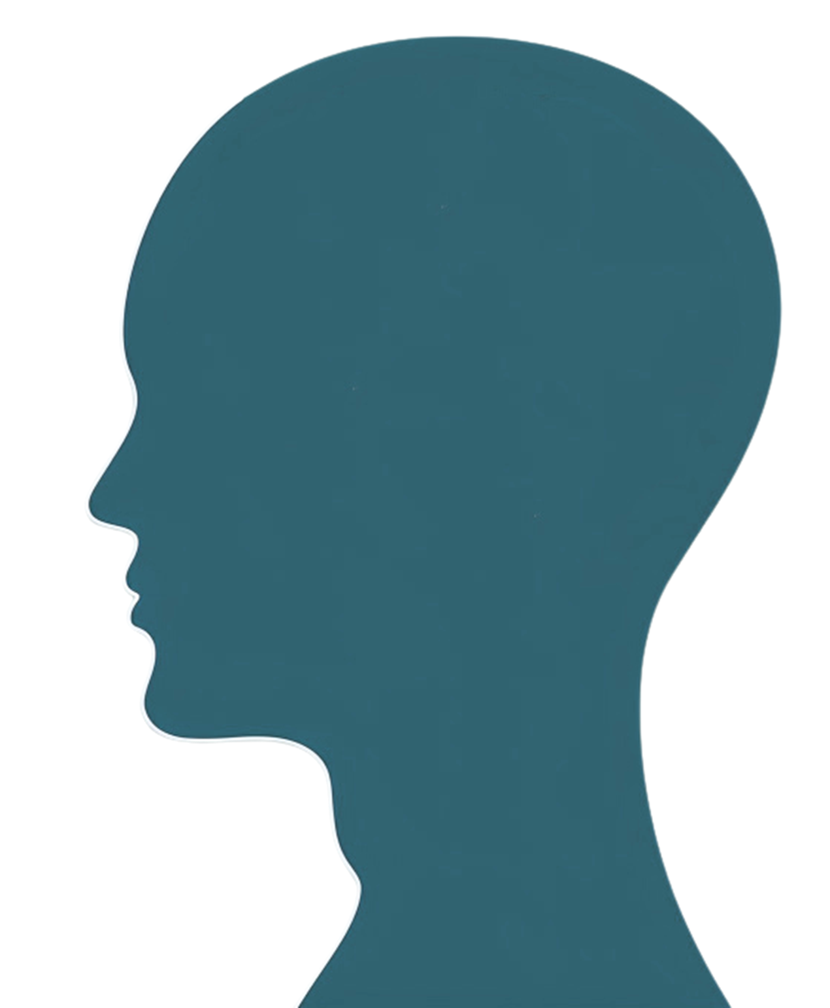
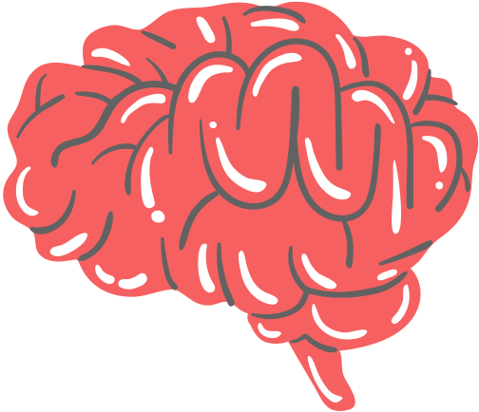

Dataset Exploration
Our data + PCAs
Notes:
Maggie

Slide 8
OUR DATASET
HOME
AUD
101
Non AUD
93
Variable | Case | Control
Depression | 83 | 18
Smoking | 56 | 45
Variable | Case | Control
Depression | 42 | 51
Smoking | 48 | 45
Notes:
Split into depressed/smoked

Slide 9
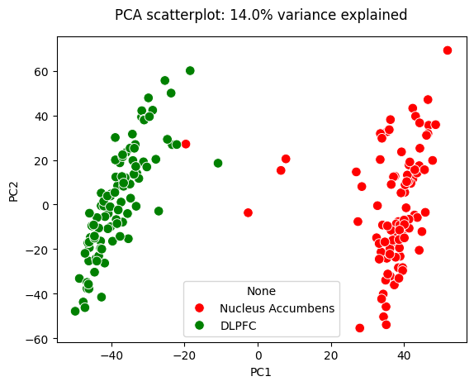
Initial PCA
HOME
Using top 25% varying genes

Slide 10
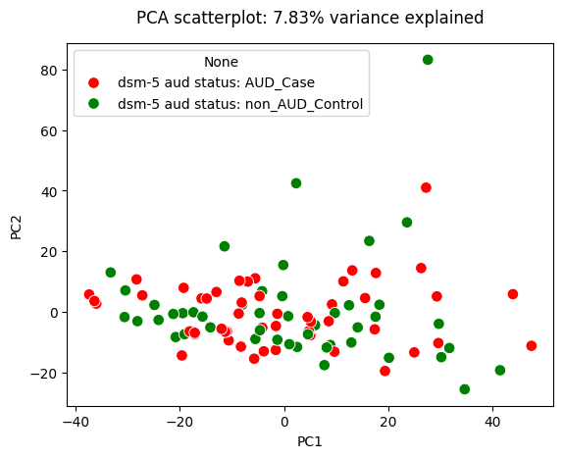
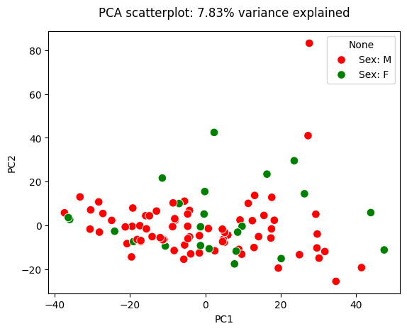
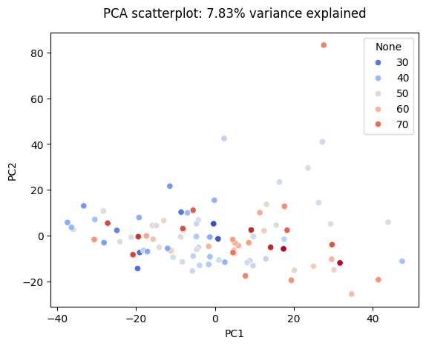
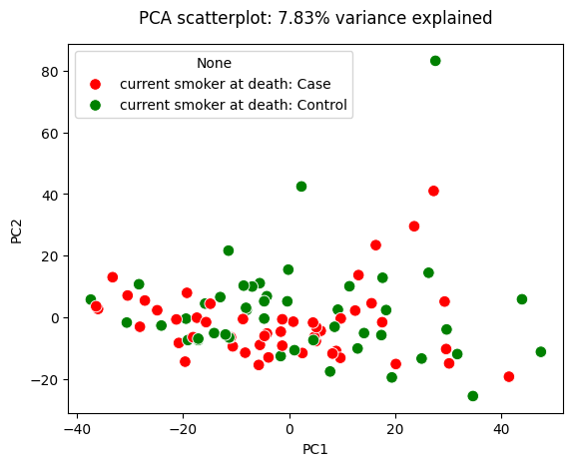
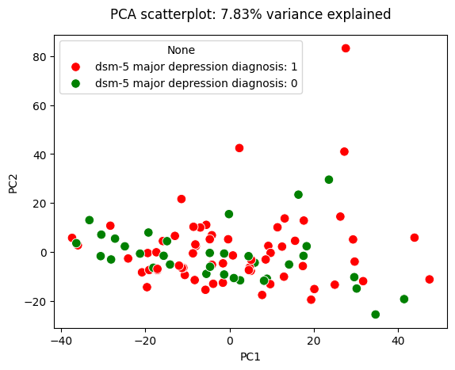
PCAs After Filtering For Prefrontal Cortex
HOME
Using top 25% varying genes
AUD vs Non AUD
Female vs Male
Age
Smoking vs Non Smoking
Depressed vs Non Depressed

Slide 11
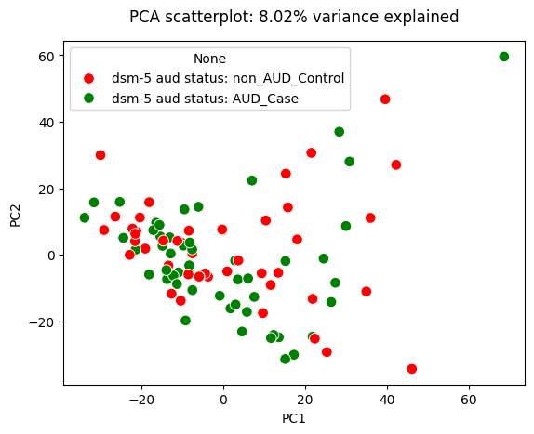
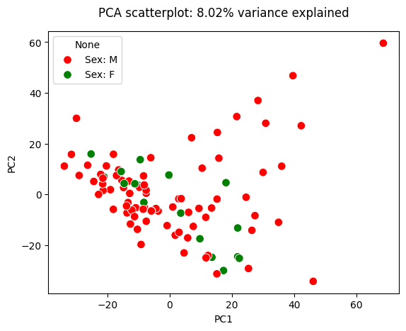
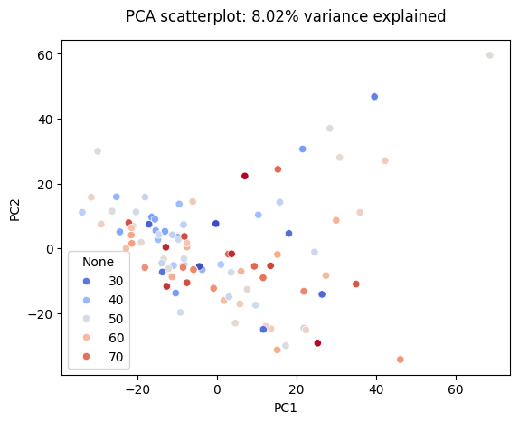
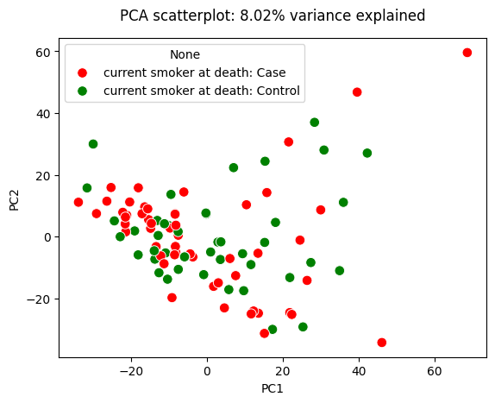
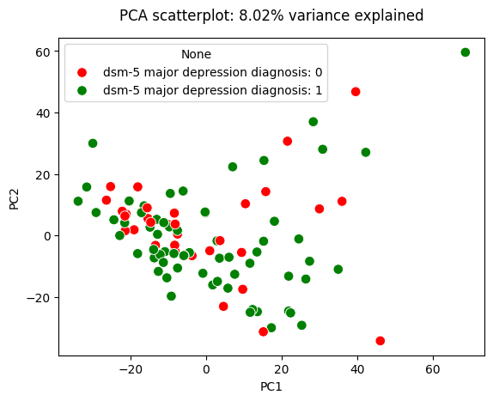
PCAs After Filtering For Nucleus Accumbens
HOME
Using top 25% varying genes
AUD vs Non AUD
Female vs Male
Age
Smoking vs Non Smoking
Depressed vs Non Depressed
Notes:
Didn’t find any significant clustering for any of these categories

Slide 12
AIM 1
Comparing Smoking & Depression DEGs with the AUD DEGs
Notes:
Aliya

Slide 13
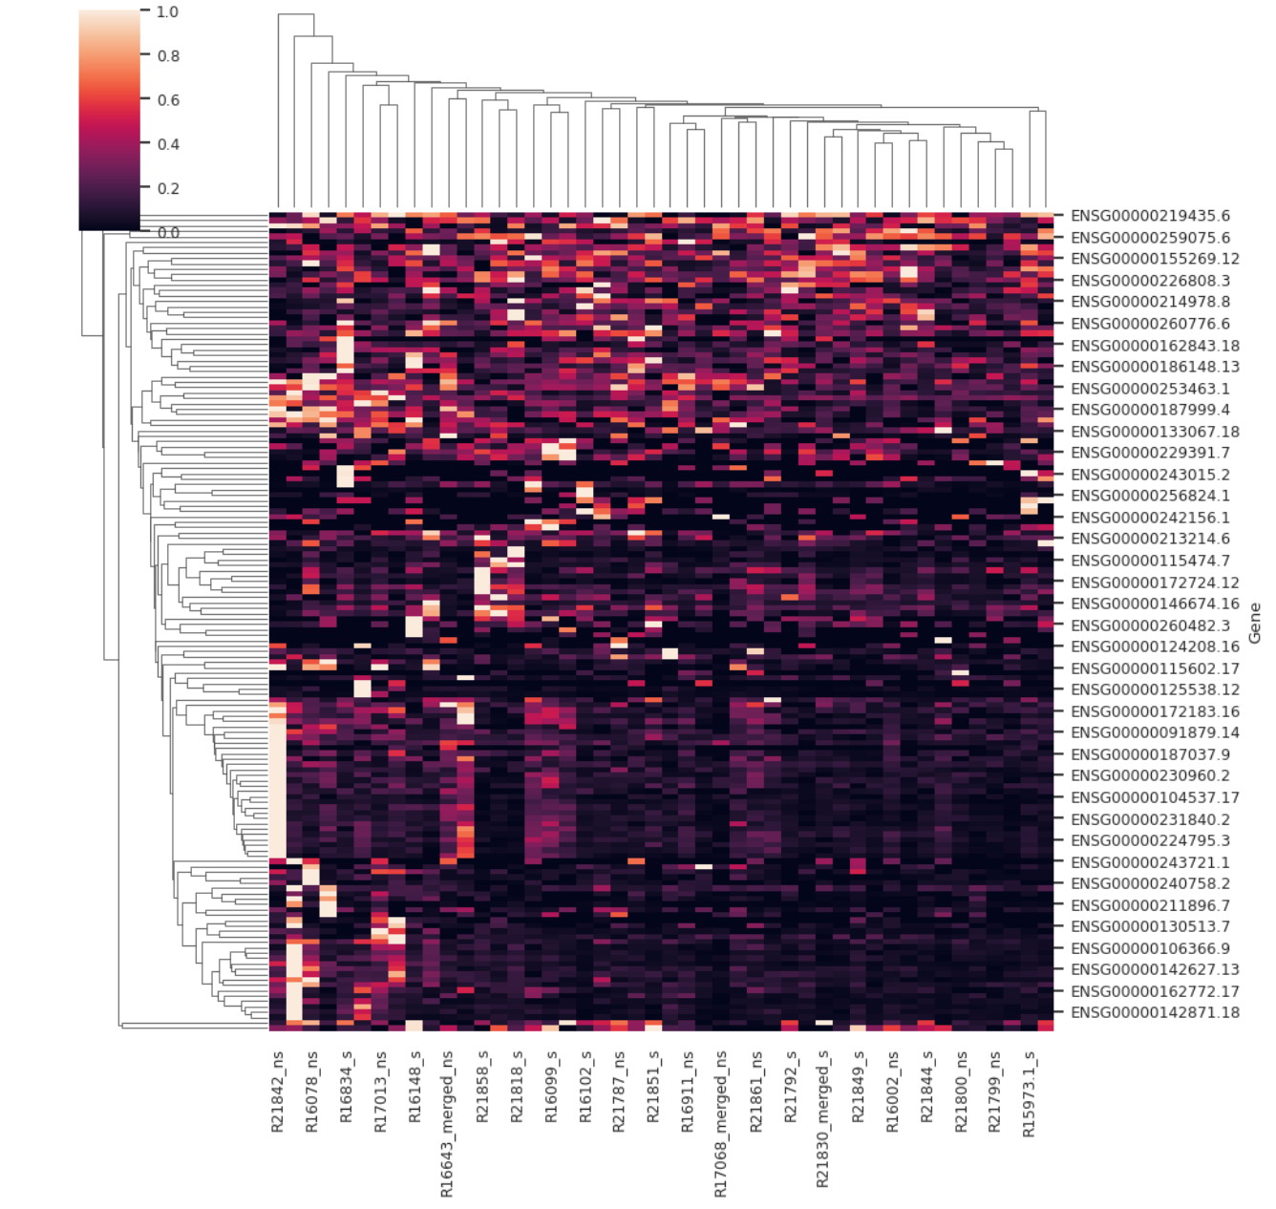
AIM 1
METHODS- SMOKER STATUS
Differentially Expressed Genes: 152
P-Value: <0.05
Cutoff Value for log₂fold change: 0.5
Filtered to only prefrontal cortex
INPUT: Gene Expression in smokers vs non-smokers (Non-AUD).
TAKEAWAY:
Smoking doesn’t show a consistent effect on gene expression in the absence of AUD
Large variation, possible underlying biological differences or environmental influences
Notes:
Aliya

Slide 14
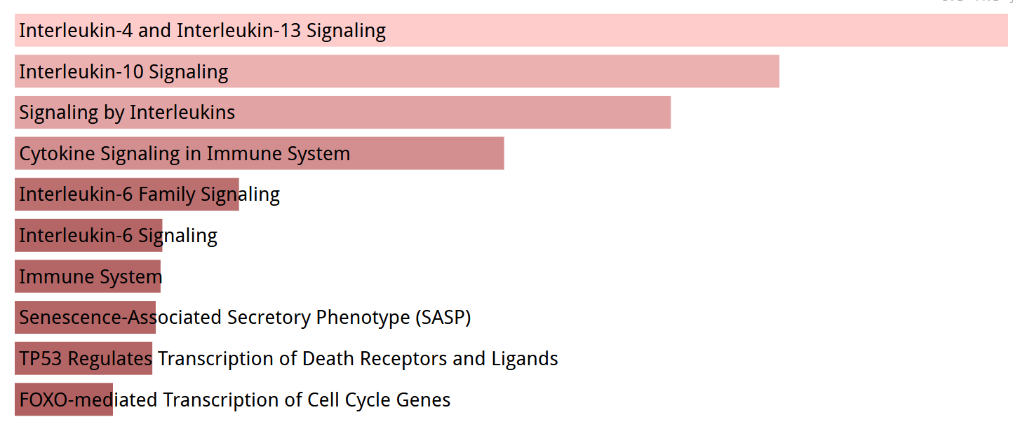
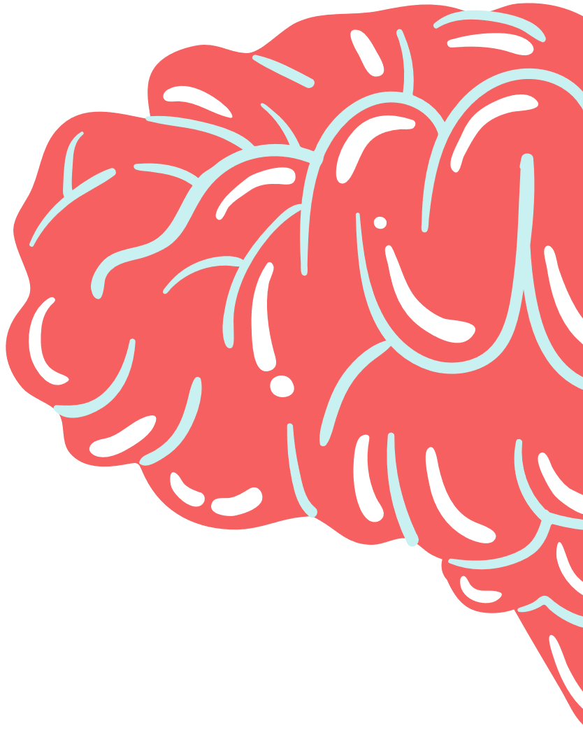
Biological Pathways using DEGs- SMOKER STATUS
Input: 152 Differentially Expressed Genes for smoker vs non-smokers (Non-AUD).
IMMUNOLOGY-
Cytokines like IL-4 and IL-13 play roles in immunity regulation and anti-inflammatory responses
Smoking can lead to neuroinflammation
Less IL-4 = less immune regulation = more inflammation in the brain
Altered IL-13 signaling may increase vulnerability to addiction
These changes reflect an immune imbalance in the brain caused by smoking
Notes:
aliya

Slide 15
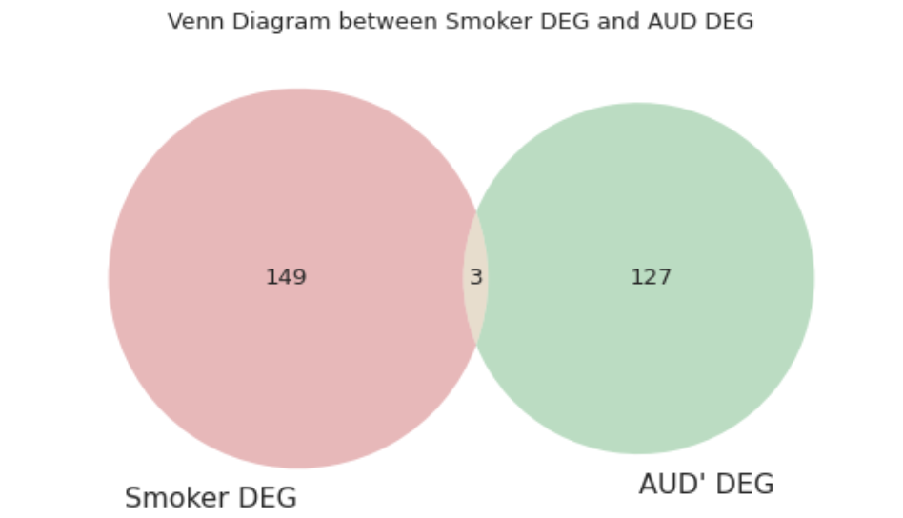
Comparison of DEGS
INPUT: Smoker Status DEG (152), AUD DEGs- (AUD vs controls) (130). Filtered through only PFC
TAKEAWAY: With the 3 overlapping DEGs of Smoker status and AUD, we determined that they represent core genes that contribute to shared neuro responses. Also have distinct molecular signatures, expressed through different biological mechanisms, even though both affect brain.
Notes:
aliya
Include how researchers found degs

Slide 16
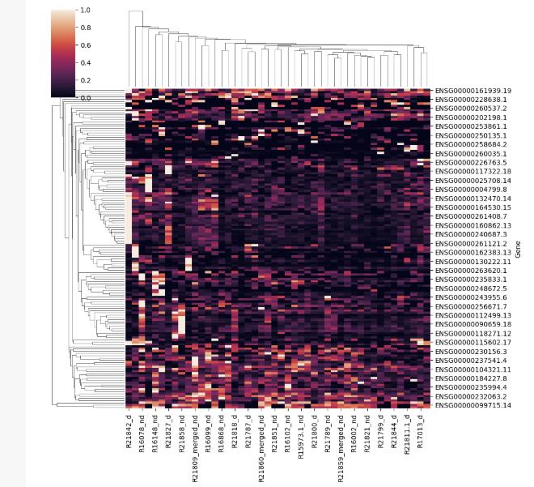
AIM 1- Cont.
METHODS- DEPRESSION
Differentially Expressed Genes: 142
P-Value: <0.05
Cutoff Value for log₂fold change: 0.5
Filtered to only prefrontal cortex
INPUT: Gene Expression in depressed vs nondepressed individuals (Non-AUD).
TAKEAWAY:
Depression status doesn’t show a consistent effect on gene expression in the absence of AUD
Gene expression could be affected by factors outside of depression
Notes:
rin
Include overlap of smoker and depression DEG with ones found in paper. (How i found DEG, heatmap, # deg, pathways) In methods: involve p value and cutoff values, log2fold change
Gene expression could be affected by outside factors (not depression), which is why the d and nd samples are not clustering together

Slide 17
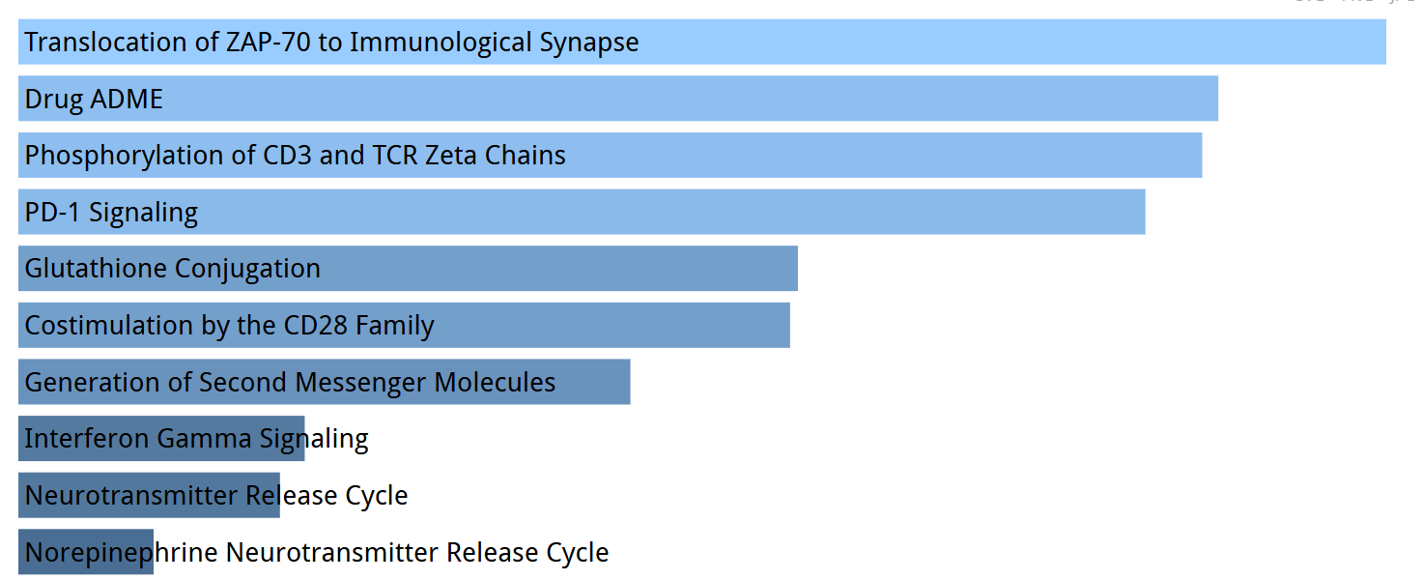
Biological Pathways using DEGs- DEPRESSION STATUS
IMMUNOLOGY-
The top pathways suggest a connection between immune system activity and depression. ZAP-70 translocation, CD3/TCR phosphorylation, and PD-1 signaling are all involved in T-cell activation and regulation, indicating possible immune imbalance or chronic inflammation — both of which have been linked to depression.
Notes:
rin

Slide 18
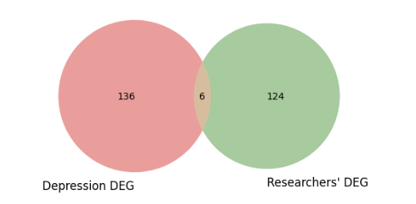
Depression DEG vs AUD DEG
AUD
INPUT: Depression DEG (142), AUD DEG (130). Filtered to PFC brain region only.
TAKEAWAY: There were 6 DEGs that were both associated with depression and AUD DEGs; these 6 genes may contribute to neurological responses in the PFC.
Notes:
rin
Overlap between depression DEG (with no AUD) and researcher’s AUD DEGs

Slide 19
DEG Overlap between Smoker and Depression with AUD
Once overlapped genes were gathered, while they didn’t reach statistical significance (adjusted p-values were not below 0.05 threshold) , after looking more into their specific function, we were able to make two major correlations. Neuroinflammation and role in immunity.
SMOKER/ AUD: IL1B: Triggers inflammation; key in neuroimmune signaling.
IL1RL1: Immune receptor; modulates inflammation via IL-33.
LINC01115: Long non-coding RNA; may regulate cell signaling.
DEPRESSION/ AUD: RGPD2: Involved in protein transport into the nucleus.
FAM225B: Non-coding RNA; linked to cell growth and migration.
PDK4: Alters brain energy metabolism; shifts fuel use.
RP11-848G14.5: Poorly understood non-coding RNA.
C10orf105: Uncharacterized; possible regulatory role.
Notes:
Aliya

Slide 20
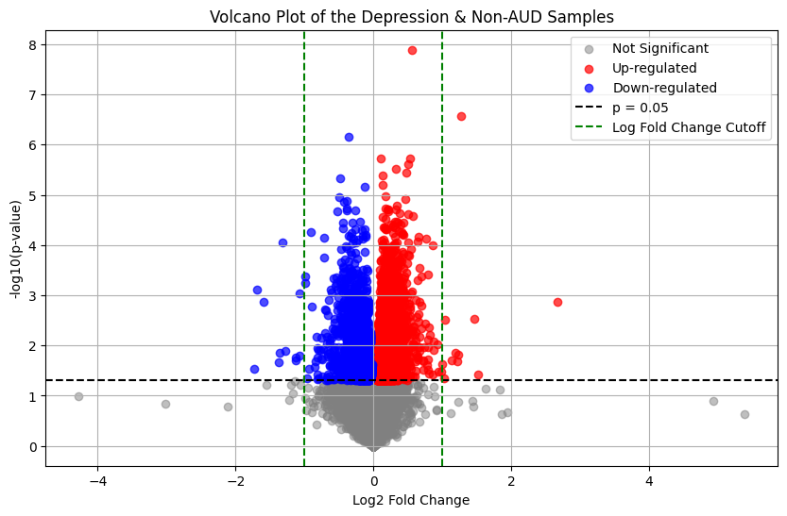
DEGs for Depression in non-AUD Samples
Notes:
Greg

Slide 21
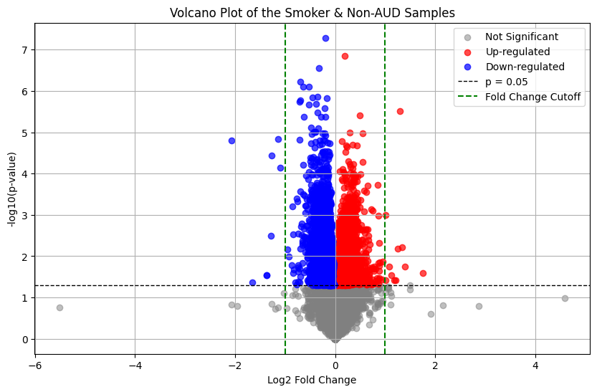
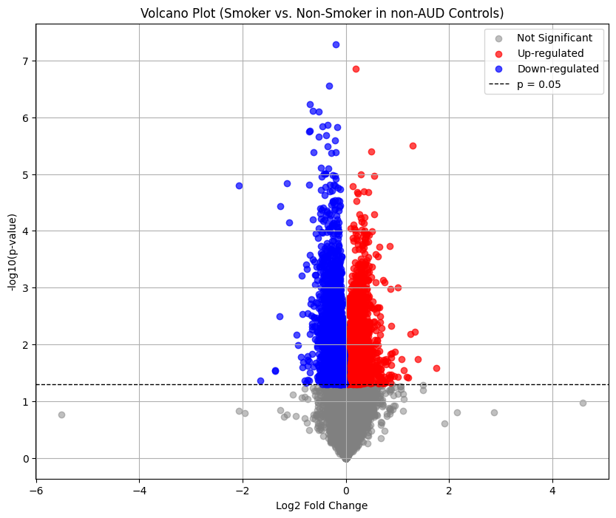
DEGs for Smoking Status in Non-AUD Samples
Notes:
Greg

Slide 22
AIM 2
Creating K-Nearest Neighbors (KNN) Model
Notes:
Swayam

Slide 23
Methods
1. Determine DEGs found by researchers
Search through the research paper for the AUD vs non AUD DEGs that the researchers found for both the PFC and NAc
2. Filter counts matrix to only include DEGs
Filter the counts matrix to only include the DEGs found by the researchers for each of the respective brain regions
3. Split into training and testing data
Split the counts data into 70% training and 30% testing data
Training: 67 samples
Testing: 29 samples
4. Build KNN model
Train model using set aside training data
Test model using set aside testing data
Report accuracy of model
5. Find most accurate k number of neighbors
Use loop to keep training model with different odd numbers of k
Track accuracies for each k
Determine the most accurate but lowest k

Slide 24
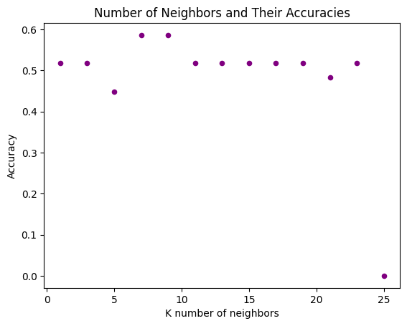
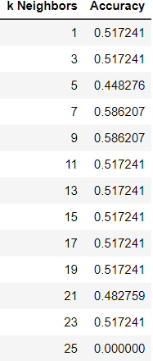
KNN Model For PFCs
HOME
Using 447 PFC DEGs found by researchers (p-value < 0.05, matching effect directions)
Notes:
Add features
Remember to mention that they are not very accurate
7 most significant

Slide 25
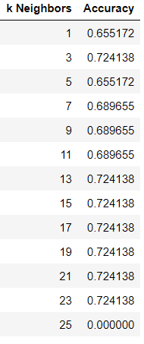
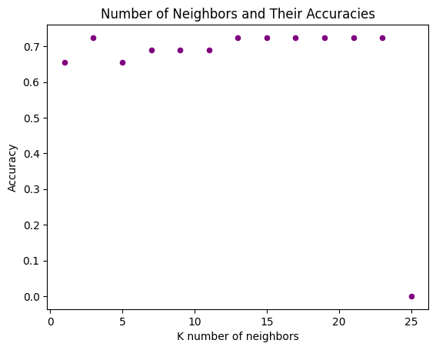
KNN Model For NAc
HOME
Using 54 NAc DEGs found by researchers (p-value < 0.05, matching effect directions)
Notes:
Remember to mention that they are not very accurate
3 most significant

Slide 26
Conclusions and Future Directions
Notes:
Greg

Slide 27

Results
Comparing DEGs
KNN Classifier
1
2
Analyzed DEG Pathways- Each overlapping DEG (3 from smoker and 6 from depression) shared the same correlation of being cytokines that play a role in either pro/anti inflammatory effects in neuroinflammation.
Found 3 overlapping DEGs for smoking DEGs and AUD DEGs
Found 6 overlapping DEGs for depression DEGs and AUD DEGs
Built 2 KNN models, one for each brain region (PFC and NAc)
Tested for the most accurate k neighbors
Concluded both models are not accurate enough to be medical-grade
Not a lot of overlap between DEGs → not many AUD DEGs are affected by smoking/depression
Notes:
Greg - not much of an overlap

Slide 28
Future Directions
AIM 1
Research biological pathways more in depth
Compare DEGs of more variables to see if there are any more confounding variables such as sex
AIM 2
Use K-fold cross validation to train a more robust KNN model
Use more optimal machine learning models that may be more suitable for our dataset
Notes:
Greg

Slide 29
References
Cheng, Hui G., et al. “Prospective Relationship of Depressive Symptoms, Drinking, and Tobacco Smoking among Middle-Aged and Elderly Community-Dwelling Adults: Results from the China Health and Retirement Longitudinal Study (CHARLS).” Journal of Affective Disorders, Elsevier, 11 Feb. 2016, www.sciencedirect.com/science/article/pii/S0165032715310120.
Husky, Mathilde M, et al. “Gender Differences in the Comorbidity of Smoking Behavior and Major Depression.” Drug and Alcohol Dependence, Elsevier, 11 Sept. 2007, www.sciencedirect.com/science/article/pii/S0376871607002876?via%3Dihub.
National Institute on Alcohol Abuse and Alcoholism. “Alcohol Use Disorder: From Risk to Diagnosis to Recovery.” National Institute on Alcohol Abuse and Alcoholism, U.S. Department of Health and Human Services, 6 May 2022, www.niaaa.nih.gov/health-professionals-communities/core-resource-on-alcohol/alcohol-use-disorder-risk-diagnosis-recovery#pub-toc1.
Willis, Caryn, et al. “Gene Expression Differences Associated with Alcohol Use Disorder in Human Brain.” Nature News, Nature Publishing Group, 12 Oct. 2024, www.nature.com/articles/s41380-024-02777-1.

Slide 30
Thank You!
Special thanks to Dhivya and Veda!
Notes:
Maggie

